Slide 1
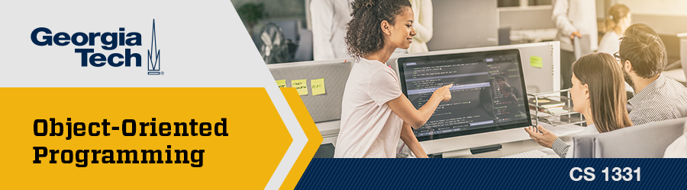
Final Exam Review /////

Slide 2
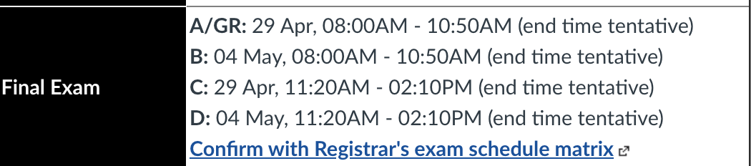
Announcements

Slide 3
Kahoot
CS 1331 S22 Final Exam Review - Details - Kahoot!

Slide 4
Topics
NOTE: THIS IS NOT A COMPREHENSIVE LIST OF TOPICS THAT WILL BE ON YOUR FINAL EXAM. IT IS JUST A REVIEW LIST OF TOPICS ROUGHLY GROUPED TOGETHER. REFER TO THE LIVING SCHEDULE FOR ALL TOPICS THAT ARE FAIR GAME FOR THE EXAM
Variables
Data Types
Expressions & Operators
Type Conversion
Strings
Printing
Scanner
Conditionals
Iteration
Packages
Math & Random
Enums
Arrays
Classes
Instance & Static Variables
Instance & Static Methods
Method Overloading
Scope
Visibility Modifiers

Slide 5
Topics (cont.)
NOTE: THIS IS NOT A COMPREHENSIVE LIST OF TOPICS THAT WILL BE ON YOUR FINAL EXAM. IT IS JUST A REVIEW LIST OF TOPICS ROUGHLY GROUPED TOGETHER. REFER TO THE LIVING SCHEDULE FOR ALL TOPICS THAT ARE FAIR GAME FOR THE EXAM
Encapsulation
Constructors
this & null Keywords
Shallow vs. Deep Copies
Wrapper Classes
Commenting & JavaDocs
Software Design & Development
Inheritance
Method Overriding
Components of a Good Class
Polymorphism
Abstract Classes
Interfaces
Comparable
ArrayList
Generics
Big-O (Asymptotics)
Searching
Sorting
Exceptions

Slide 6
Topics (cont.)
NOTE: THIS IS NOT A COMPREHENSIVE LIST OF TOPICS THAT WILL BE ON YOUR FINAL EXAM. IT IS JUST A REVIEW LIST OF TOPICS ROUGHLY GROUPED TOGETHER. REFER TO THE LIVING SCHEDULE FOR ALL TOPICS THAT ARE FAIR GAME FOR THE EXAM
File I/O
Recursion
JavaFX: Basics
JavaFX: Shapes, Colors, & Images
JavaFX: Layout
Event-Driven Programming
JavaFX: Events
JavaFX: GUI Controls
ADTs
LinkedList
Collections

Slide 7
Variables
Back to Topics List
Variable - A place in memory where a value is stored
Variable declaration & assignment:
Ex . String name = "CS1331";
Variables must be given a type at declaration
Naming:
Be descriptive​
z = x / y; is hard to read versus average = sum / numElements;​
Java uses the camelCase convention​
Can't use reserved words​
public, static, class, int, double, float, etc.​
Can’t start with a number
Constant (final) – A variable whose value cannot change once it has been assigned
Ex. final int MY_INT = 3;

Slide 8
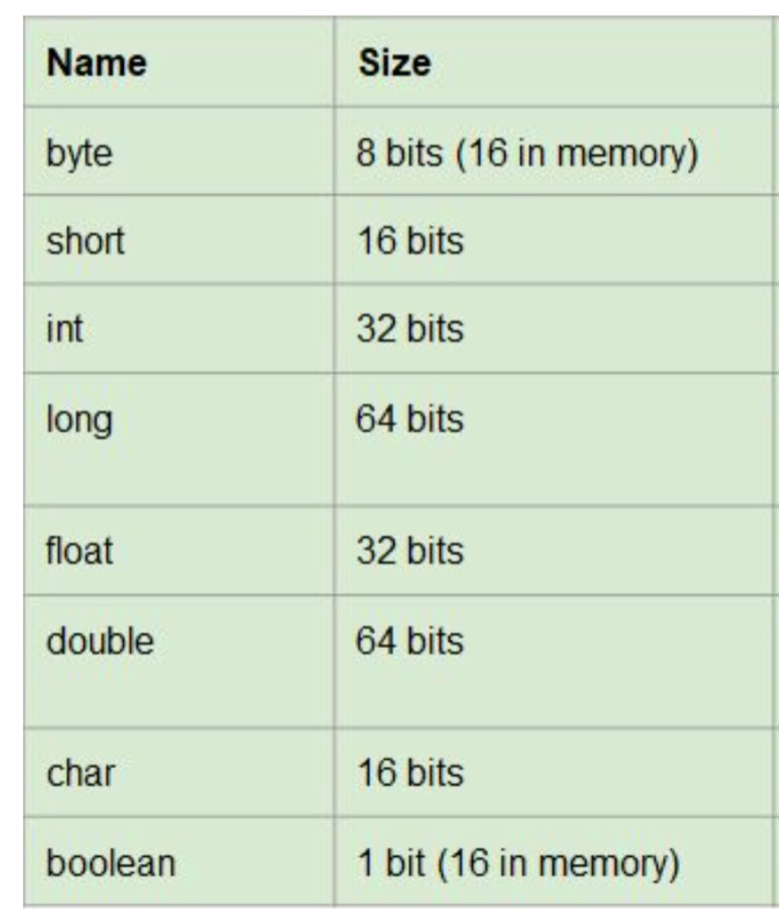
Data Types
Back to Topics List
2 Categories for the type of a variable​:
8 Primitive​ Types
Integer numbers: byte, short, int, long
Floating point: float, double
Other: char, boolean
Object/Reference Types
Ex. String, Scanner, etc.

Slide 9
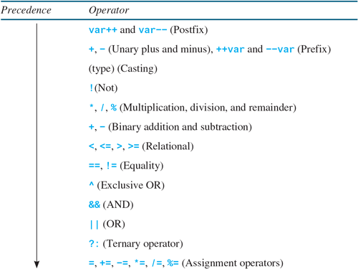
Expressions & Operators
Back to Topics List
Expression - Combination of 1 or more operators and operands
Ex: int total = 2+ 3 *5;
Operators of the same precedence are evaluated from left to right
Use parentheses to force precedence

Slide 10
Type Conversion
Back to Topics List
Narrowing vs. Widening:
Narrowing: Bigger goes to smaller (loses precision)
Ex. double d = 2.00;
int i = (int) d;
Widening: Smaller goes to bigger (doesn’t lose precision)
Ex. byte b = 5;
int i = b;
Explicit vs. Implicit Casting:
Explicit: Must be done for narrowing conversions to avoid compile time error
Does NOT change the original variable
Implicit: Done automatically

Slide 11
Strings
Back to Topics List
Used to represent a sequence of characters
Are objects -- not a primitive data type
Strings are immutable meaning you cannot change them
Strings can be created the following ways:
String aStr = "Welcome to Recitation 3!";
String aStr = new String("Welcome to Recitation 3!");
String concatenation
"H" + "E" + "L" + "L" + "O" -> "HELLO"
"12" + "3" -> "123”
Check out the Java API for useful String methods:
https://docs.oracle.com/javase/7/docs/api/java/lang/String.html
Note: String operations return a new String so you must reassign the result to a String variable

Slide 12
Printing
Back to Topics List
System.out.print() - prints on the current line
System.out.println() - prints and then adds a new line character at the end
System.out.printf() - prints with formatting depending on the specifiers
%[flags][width][.precision]conversion-character
Conversion characters:
s - Strings
d - decimal integers
f - floating-point numbers
c - characters

Slide 13
Scanner
Back to Topics List
Method | Definition
hasNext() | Checks if Scanner has another token in its input.
hasNextLine() | Checks if Scanner has another line in its input.
next() | Reads the next String token.
nextLine() | Reads the next line as a String.
nextInt() | Reads the next int token.
nextDouble() | Reads the next double token.
The Scanner class allows us to get user input by breaking it up into tokens (whitespace by default)
Useful to read user input or read from files
You can create a Scanner as follows: Scanner myScanner = new Scanner(System.in);
Must import java.util.Scanner;
Always create just one Scanner!

Slide 14
Conditionals
If/Else Statement:
if details code to be executed, if the specified condition is true
else if details code to be executed, if the first condition is false and the specified condition is true
else details code to be executed, if the same condition is false for all above cases
Ternary Expression:
variable = expression1 ? expression2 : expression3;
If expression1 is true, then expression2 is executed
If expression1 is false, then expression3 is executed
Switch Statement:
One case statement for each of the possible values the variable can take
default statement is optional and will only be used if none of the previous cases were true
Always put a break statement after each case to avoid fall through!

Slide 15
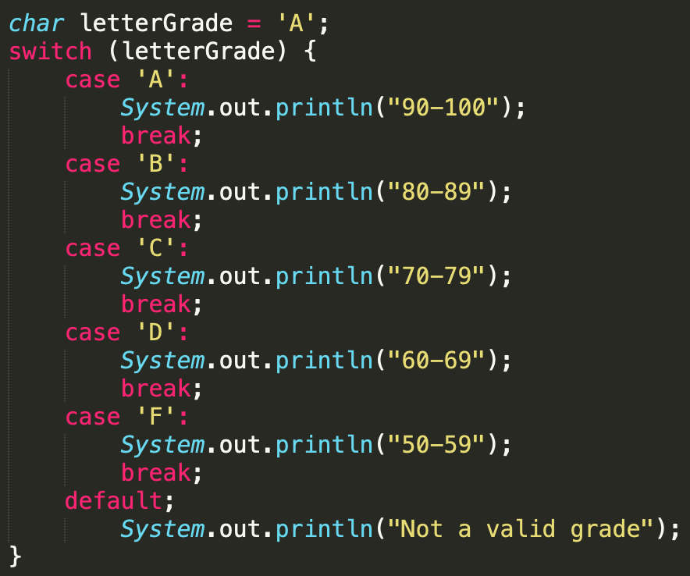
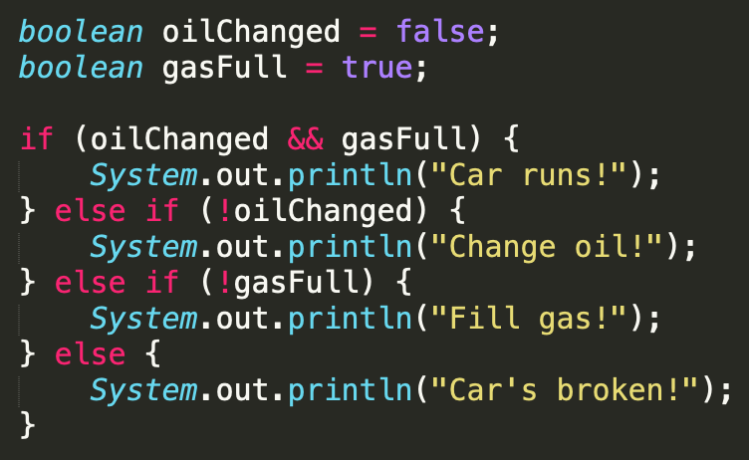
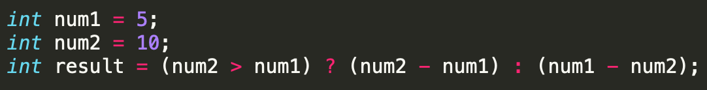
Conditionals (examples)
Back to Topics List

Slide 16
Iteration
While Loops:
Execute as long as the conditional statement is still true
The conditional statement is evaluated before beginning the loop
Use when you don't know exactly how many times the code will repeat
Do While Loops:
Very similar to while loops in concept
The conditional statement is evaluated after the loop.
Tip: Use when you always want to execute a certain block of code at least once
For Loops:
3 components: initializer, condition, update
The condition is checked before each iteration (including the first iteration)
The update is executed after each iteration
Tip: Use when you know exactly how many times the code will repeat
For Each Loops:
Does not store index, cannot modify array, and always iterates forward
Tip: Use to iterate over an array

Slide 17
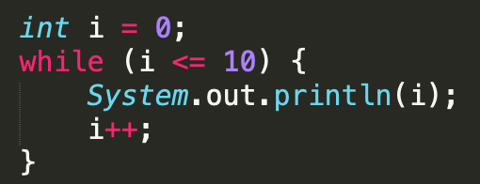
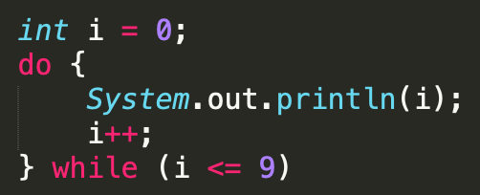
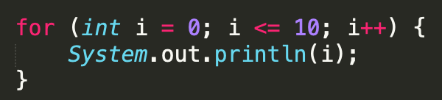
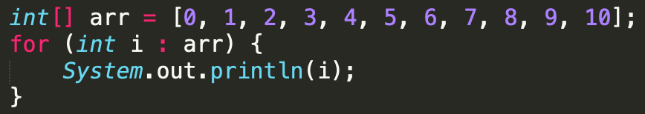
Iteration (examples)
Back to Topics List

Slide 18
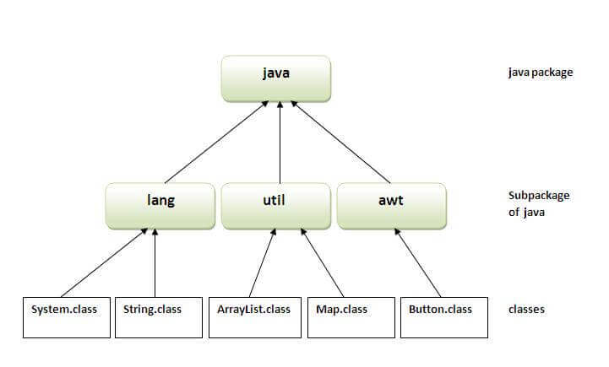
Packages
A package is a collection of related classes that lets us implement functionality that we don’t have to code ourselves
Common Packages we've used:
java.lang (automatically imported)
Math, String, System
java.util
Random, Scanner
Two ways to import a class:
import java.util.*
import java.util.Scanner

Slide 19
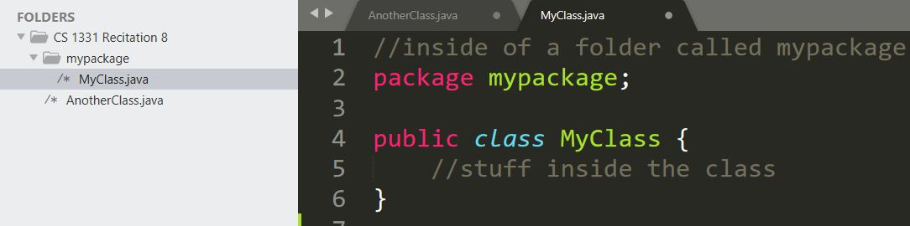
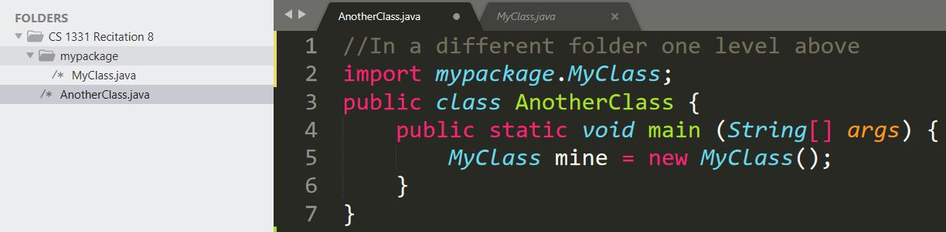
Creating Packages
Back to Topics List
Useful for grouping together classes with similar purposes or functions
In order to create a package :
Create a folder that is the name of the package
Place all classes inside the folder you make
Include the package <folder name> at the top of each class in the package (folder)

Slide 20
Math & Random
Back to Topics List
Math:
Contains many useful static methods for common mathematical operations
https://docs.oracle.com/en/java/javase/11/docs/api/java.base/java/lang/Math.html
Lives in java.lang -- it is automatically imported
One very important method:
Math.random() //produces a pseudo-random value between [0.0, 1.0)
Random:
Requires instantiating as an object to use
Random rand = new Random();
Need to import java.util.Random;
Useful methods:
rand.nextInt(int bound); //produces a number between [0, bound)
rand.nextDouble(); //returns double in bounds [0.0, 1.0);
Formula for random bound [lower, higher] (inclusive):
rand.nextInt(higher – lower + 1) + lower

Slide 21
Enums
Back to Topics List
Represent a group of unchangeable values (constants). The only possible instances. You can't create a new instance of Planets using new Planets()
public enum Planets {
MERCURY, VENUS, EARTH, MARS, JUPITER,
SATURN, URANUS, NEPTUNE }
Important Enum methods:
name() - returns the name of the enum in the form of a String
ordinal() - returns the enum’s index in the declaration
How to use Enums:
Planets myPlanet = Planets.VENUS;
myPlanet.name() ---> "VENUS"
myPlanet.ordinal() ---> 1

Slide 22
Arrays
Arrays are objects that contain multiple elements of the same type
Needs a capacity. It cannot be changed!
Ways to declare an array:
int[] arr = {2, 4, 6};
int[] arr = new int[]{2, 4, 6};
int[] arr = new int[3]; //automatically default values arr[0] = 2; arr[1] = 4; arr[2] = 6;
Can get capacity using length property
int len = arr.length; //NOT arr.length()

Slide 23
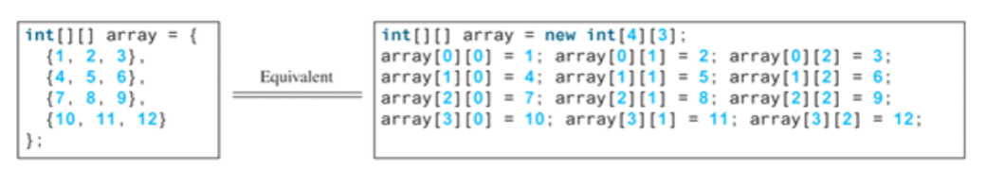
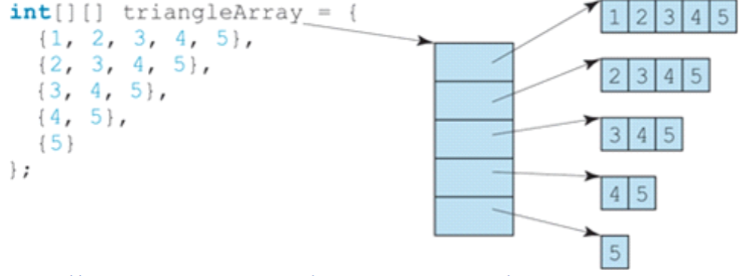
2D Arrays
Back to Topics List
Can store multiple arrays AKA an array of arrays
int[][] arr2D = new int[rows][cols];
Can be rectangular – same number of columns in each row
int[][] arr2D = {
{1, 2, 3}, // row 0
{4, 5, 6}, // row 1
{7, 8, 9} }; // row 2
Can be “ragged” – different number of columns in different rows
Ex: int[][] raggedArr = new int[2][];
raggedArr[0] = {1,2,3};
raggedArr[1] = {3,4};

Slide 24
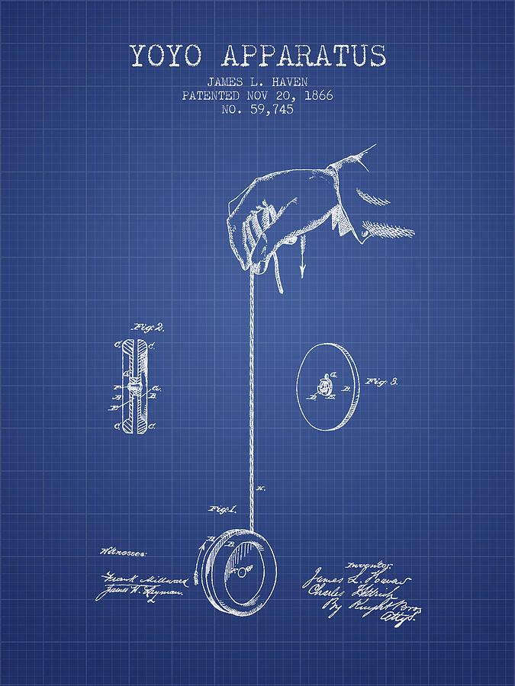

Classes
Back to Topics List
A class is a blueprint that an object can be created from
An object is an instance of the class
There can be many different objects of one class with different data
Classes can have instance data, constructors, and methods
objects of the class
class

Slide 25
Instance & Static Variables
Instance & static data should be private so that it can only be changed through method calls
Each class-level variable has a default value
int | double | boolean | char | Any object reference
0 | 0.0 | false | '\u0000' | null
Notes:
stringLength and radius are inches, blueYoyo and redYoyo are the instances of Yoyo

Slide 26
Instance & Static Variables (cont.)
Back to Topics List
Instance Variables | Static Variables
Data only belongs to that object. So methods called on that object change that variable will only change for that object | Data is shared, so it changes for all instances also.
Cannot be used in static methods | Can be used in instance and static methods
Assigned default values if not given. | Assigned default values if not given.
Useful for any data that is specific to one object. | Useful as counters, constants, etc. Anything that is shared between objects of the same class.
Notes:
stringLength and radius are inches, blueYoyo and redYoyo are the instances of Yoyo

Slide 27
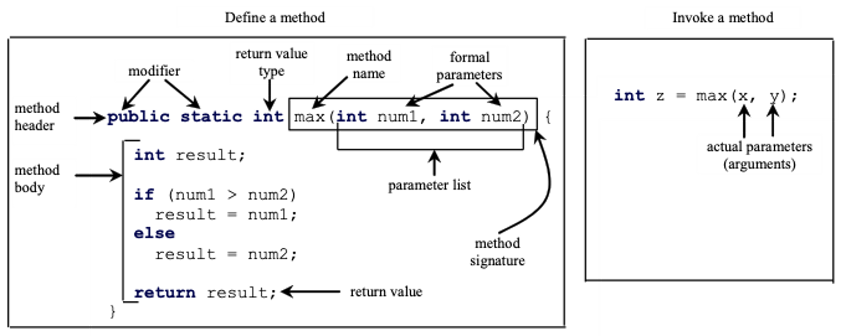
Instance & Static Methods
Method signature: comprised of method name and formal parameter types. NOT return type

Slide 28
Instance & Static Methods (cont.)
Back to Topics List
Instance Methods | Static Methods
No keywords required in method header | static keyword in method header
Can only be called on an object | Can be called on an object or class
Can use static and instance data | Can only use static data
Ex: Getter, Setter methods | Ex: Math.random()

Slide 29
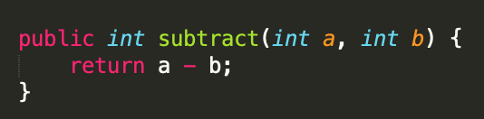
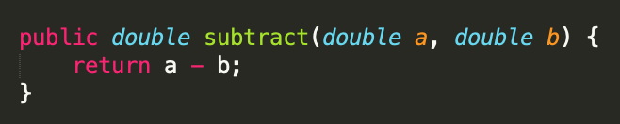
Method Overloading
Back to Topics List
You can have more than one method with the same name as long as they have different parameter lists
Different number of parameters or different data types
No two methods within a class can have the same method signature because the JVM won’t know which method to invoke

Slide 30
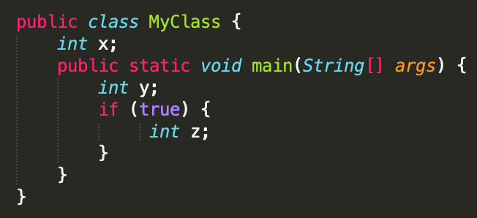
Scope
Back to Topics List
Variables have an attribute called scope, which determines where in code they are accessible from
Class Level Scope / Members:
Scope of x: Anywhere in the MyClass class.
Method Level Scope / Local Variables:
Scope of y and args: Anywhere in the main method, cannot be accessed outside main
Block Level Scope / Loop Variables:
Scope of z: Only inside the if block.

Slide 31
Visibility Modifiers
Back to Topics List
​ | Private​ | Package Private | Protected​ | Public
Any class | ✗​ | ✗ | ✗ | ✓​
Subclass | ​✗​ | ​(only if in same package) | ​✓​ | ​✓​
Package | ✗​ | ✓ | ✓ | ✓​
Within the class | ✓ | ✓ | ✓ | ✓

Slide 32
Encapsulation
Back to Topics List
A way to protect the data from being accessed outside of the class
To achieve encapsulation:
Declare all the variables in the class as private
Write public methods in the class to set and get the values of variables. These are commonly known as Getters and Setters.
public String getName( ) {​
return this.name;​
}​
public void setName(String name) {​
this.name = name;
}​

Slide 33
Constructors
A special type of method that creates instances of a class and initializes instance data with passed in values
No return type
If and only if you don’t have any constructors, Java makes you a default constructor that takes no args
You also have the ability to overload constructors just like method overloading
You can also chain constructors by using a this() call to delegate to an already existing constructor
Saves us from rewriting the same code
this() needs to be on the first line!
Note: the least args constructor should chain to the most args constructor

Slide 34
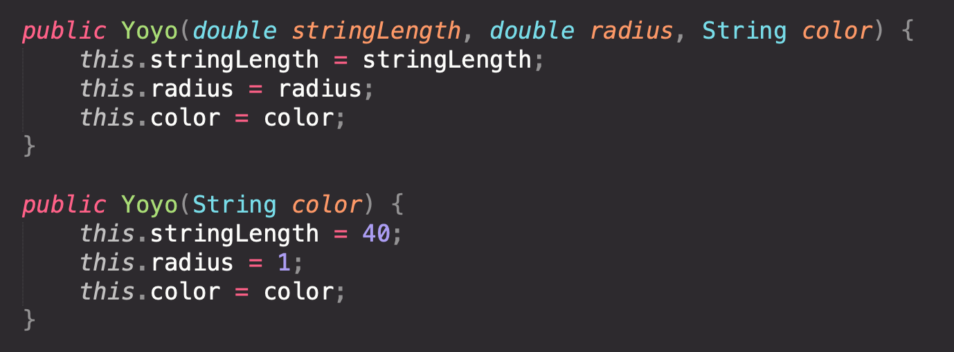
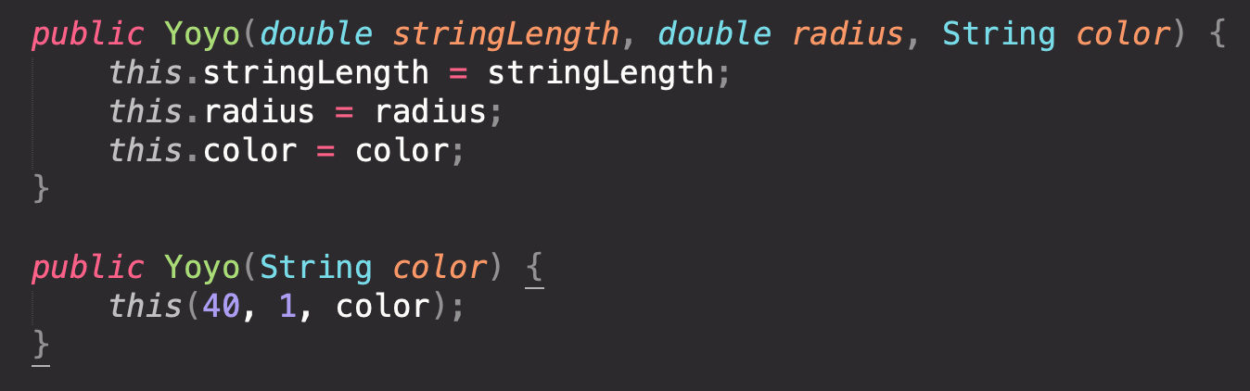
Constructor Chaining
Back to Topics List
The left side should be written like the right side

Slide 35
this & null Keywords
Back to Topics List
this
Used inside (non-static methods) to refer to the object upon which the method is being invoked
Also commonly used for constructor chaining
null
Default value for Object variables
There is no object / instance assigned to that variable
Trying to access fields or methods of null, will result in NullPointerException
Check if object == null before using it!

Slide 36
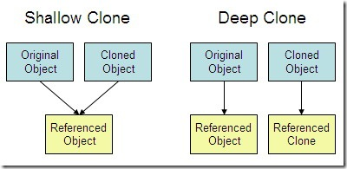
Shallow vs Deep Copies
Aliasing - Occurs when two or more references point to same location in memory
Shallow copy – Created by directly copying the reference to the original object (creates an alias)
Deep copy – Instantiated on its own (has its own unique reference) but holds the same value as the original

Slide 37
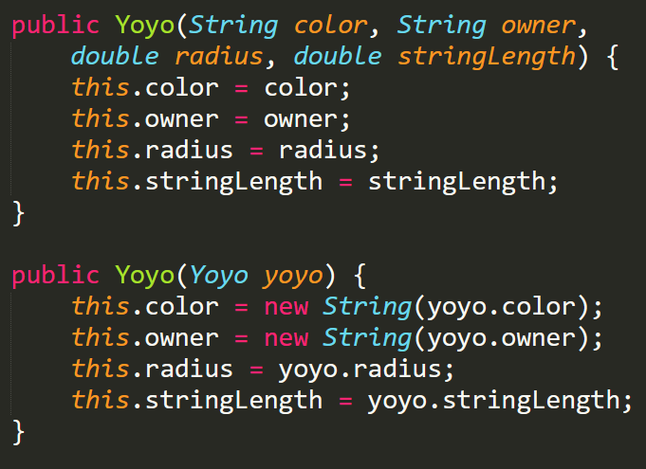
Copy Constructors
Back to Topics List
Use copy constructors to create deep copies of an Object
Yoyo redYoyo = new Yoyo("red", "Akul", 2.5, 35.5);
Yoyo deepCopyRedYoyo = new Yoyo(redYoyo);
deepCopyRedYoyo.setColor("green");
System.out.println(redYoyo.getColor());
//will print "red"

Slide 38
Wrapper Classes
Back to Topics List
Holds the same data as a primitive, but is an object (can call methods)
Corresponding wrapper class for every primitive type:
int -> Integer
double -> Double
char -> Character
boolean -> Boolean
Each of these wrappers live in java.lang

Slide 39
Commenting & JavaDocs
Back to Topics List
Single line comments​
//Comments here (Text in this line is not executed as code)​
Multiline comments​
/** Comment starts ​
* continues . . . ​
* Comment ends */
Javadocs – multiline comment that provides a description of your code
Above any method, field, or class
Explains functionality and/or parameters + return value
Tags - Help describe return value, parameters, etc.
@return, @param, @author, @version, @Override, etc.

Slide 40
Software Design & Development
Back to Topics List
Software development life cycle:
Plan – establish what requirements are
Define requirements – clearer definition of what the software is meant to do
Design – plan, draw diagrams, etc. before coding
Implement design – build the program
Test – debug, ensure program works as intended
Deploy and maintain – software is released but may need maintenance
Debugging
Print statements
Boolean control variable
IDE debugger with breakpoints

Slide 41
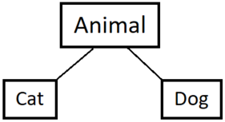
Inheritance
Back to Topics List
Parent/superclass
Child/
subclass
Child/
subclass
Classes can extend other classes to ”inherit" the methods and data from the class that they extend (only if method/data is public or protected)
Single Inheritance - A parent class can have many child classes, but child class can extend one parent class
Allows for code reuse and reduces repetition
Class implicitly extends Object if it does not explicitly extend another class
Use the super keyword to access the superclass's non-private methods/data
Use super() for constructor chaining to the superclass's constructor
Either super() or this() must be the first line of the constructor. If not included, Java will implicitly call super()

Slide 42
Method Overriding
Back to Topics List
Override a method from a parent class
Must have same method signature
Can use @Override tag to have compiler check if method is properly overridden
Overriding​ | Overloading​
Same method signature​ (Different implementation) | Different method signature​ (Different parameters)​
Subclass override parent class method | Within the same class, or subclass overloads parent class method

Slide 43
Components of a Good Class
Default implementation of the methods in Object:
toString() - unsigned hexadecimal representation of the object
equals() - reference equality
hashcode() - hash value of object (numeric)
If an object is not modified, its hashcode will remain the same
If two objects are equal, then they will have the same hashcode
If two objects have the same hashcode, they are not necessarily equal
Want to override those methods to be more specific and tailored to your class
Encapsulation, with getters and setters as needed

Slide 44
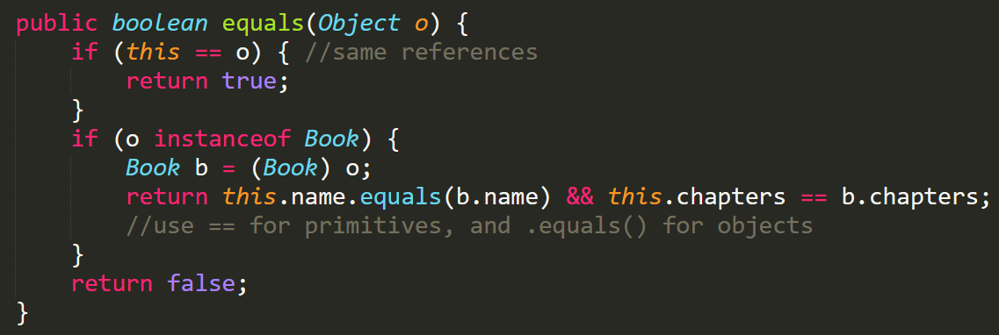
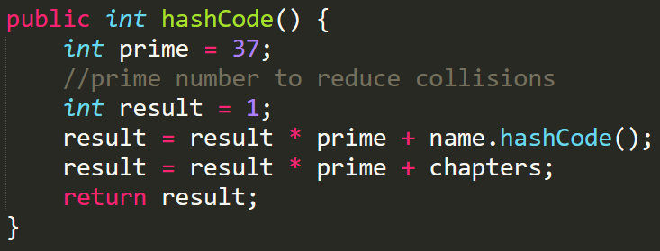
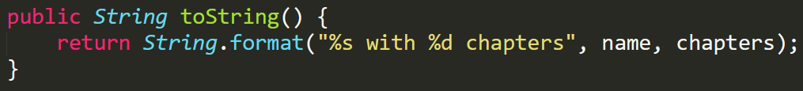
Components of a Good Class (examples)
Back to Topics List
Book has two private instance variables: String name and int chapters

Slide 45
Polymorphism
Describes the ability of an object to behave differently based on the context of the action
Static type <-> compile time. What an object is declared as
Dynamic type <-> run time. What an object is instantiated as
Dynamic type has to be the same or down the hierarchy from the Static type (dynamic "is-a" static relationship)
Bird myBird = new Woodpecker();
[Static type] [variable] = new [Dynamic type]();

Slide 46
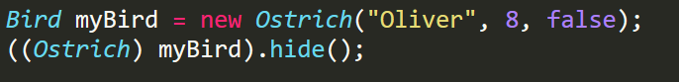
Polymorphism - Casting
Static type: Bird
Dynamic type: Ostrich
Casting:
Upcasting – always compiles, always runs
Downcasting – always compiles, sometimes runs
Sidecasting – never compiles, never runs
Object
Bird
Woodpecker
Ostrich

Slide 47
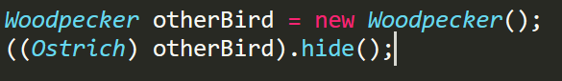
Polymorphism – Compile Time
If one line has a compile error, the whole code doesn't compile
Casting allows us to convince the compiler that a line will run
A line will compile if the method you are calling exists in the static (or casted) class or a superclass of it
Upcasting & Downcasting (think of the hierarchy) will always compile
Sidecasting will never compile
Will these compile?
will compile
will not compile

Slide 48
Polymorphism – Run Time
If the method exists in dynamic type, great! Just run it.
If the method doesn't exist in dynamic type, go up the hierarchy until you find it, then run it
If the method does not exist up the hierarchy, RUNTIME ERROR!

Slide 49
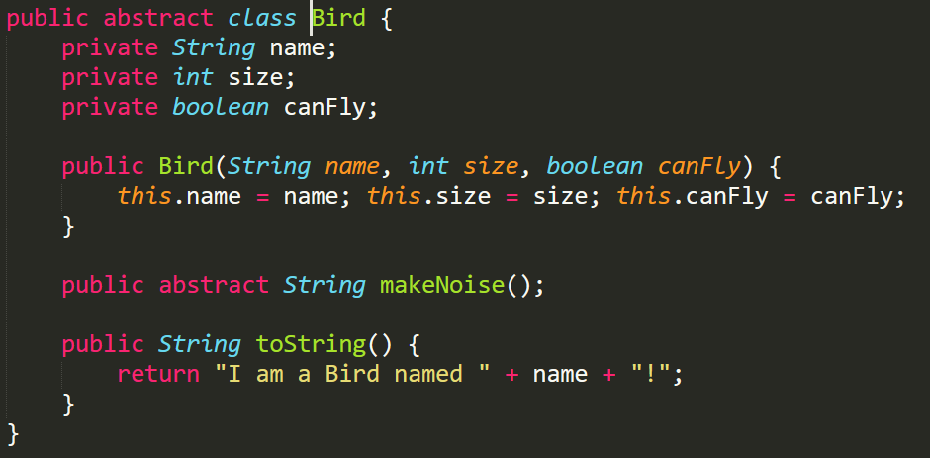
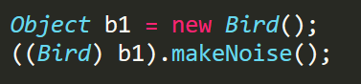
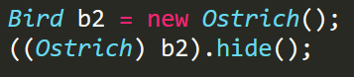
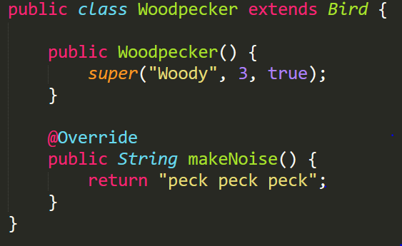
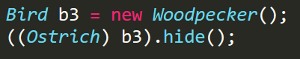
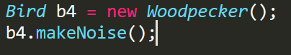
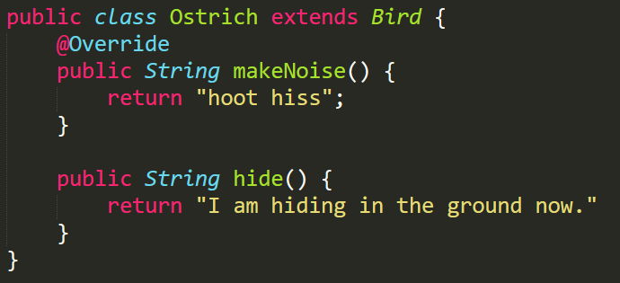
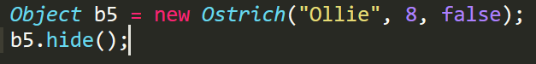
Polymorphism Practice
Compile error
Bird is an abstract class
Compile error
Bird doesn’t have a default
constructor
Runtime error
ClassCastException due to sidecasting
Runs Woodpecker's makeNoise()
Compile error
Ostrich doesn’t have a 3 arg constructor
Notes:
2) does not compile because Bird doesn't have a default constructor, nor does Ostrich

Slide 50
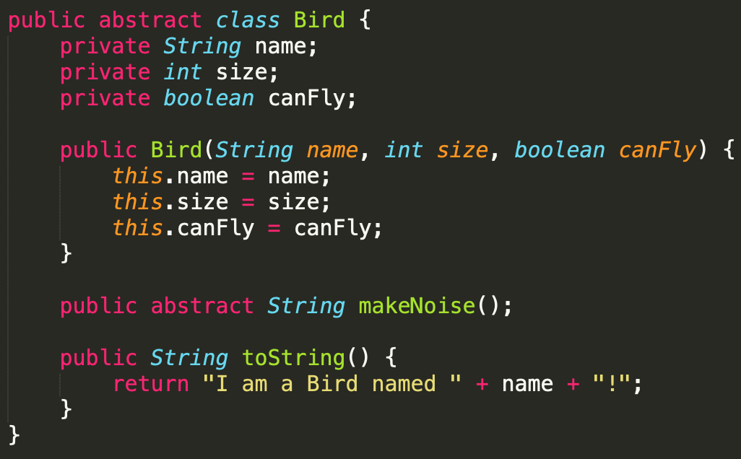
Abstract Classes
Back to Topics List
Acts as a "template" for subclasses
Cannot be instantiated
Declared using the abstract keyword
Can have: constructors, non-abstract methods, abstract methods, and instance variables
Abstract method - Just a method header in the abstract class
MUST be overridden when inherited by a concrete class
Cannot be static or final or private

Slide 51
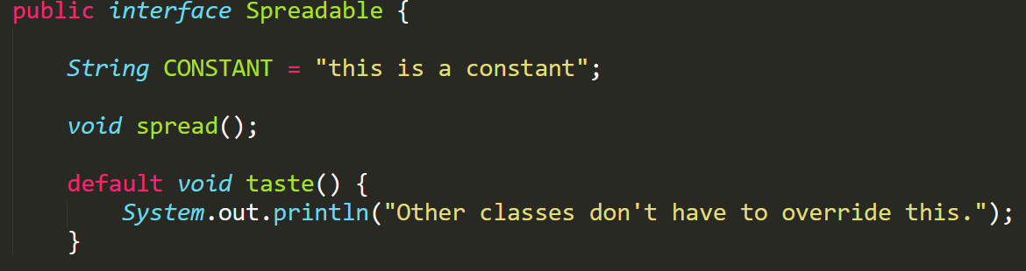
Interfaces
Back to Topics List
Acts as “contract” of what their subclasses can do
Cannot be instantiated
Declared using the implements keyword
Can have: static final variables, abstract methods, static methods, default methods
Interfaces cannot have: instance variables, concrete instance methods, constructors

Slide 52
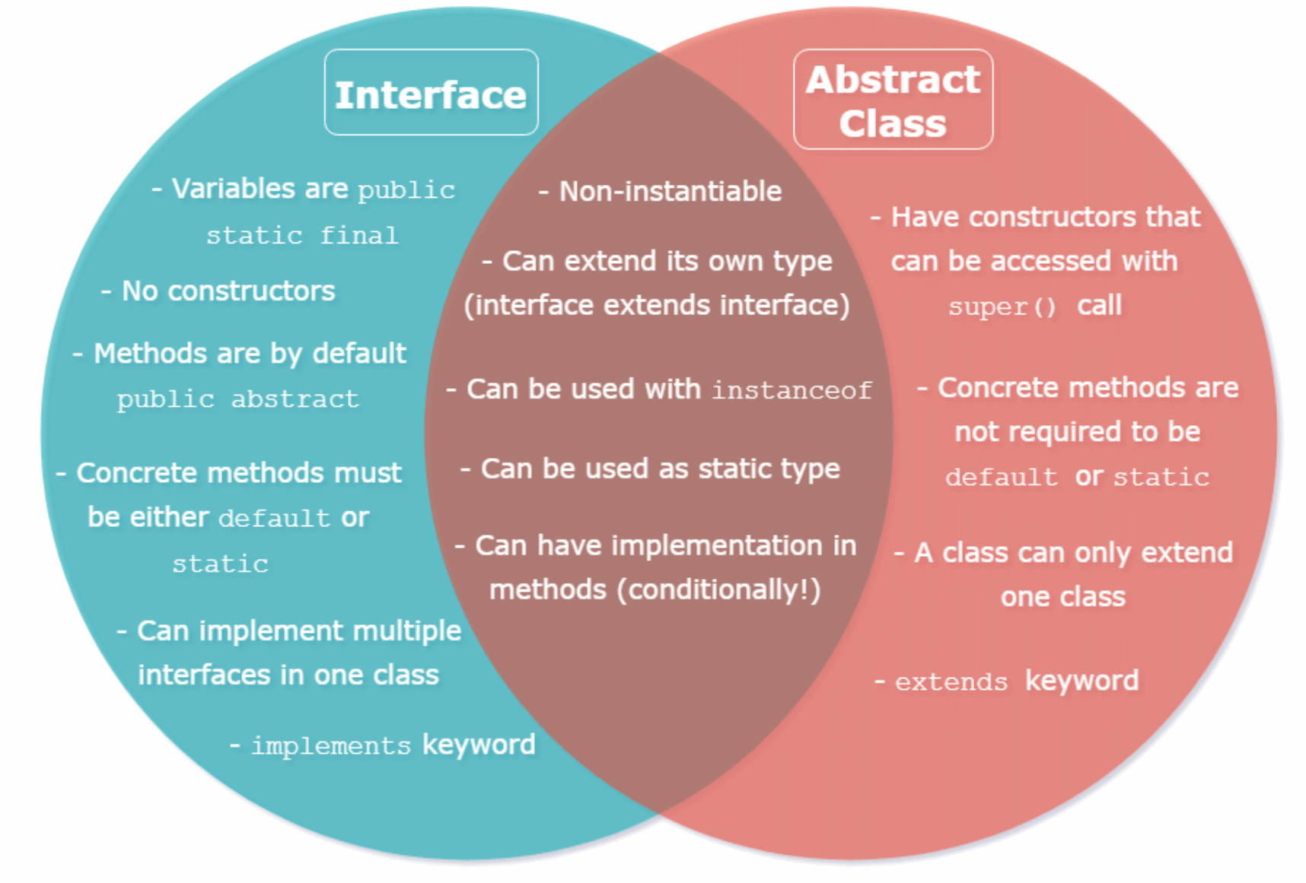
Abstract Classes vs. Interfaces
Back to Topics List

Slide 53
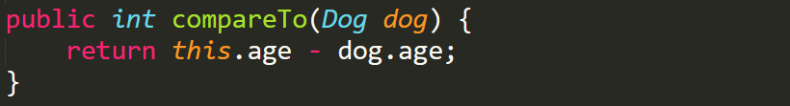
Comparable
Back to Topics List
Interface that allows classes that implement it to compare instances for order (less, greater, equal)
Any class that implements must have .compareTo() implemented
Return int < 0 if this is less than other
Return int > 0 if this is greater than other
Return 0 if the two are equal

Slide 54
ArrayList
Back to Topics List
Resizable
Can only hold Objects not primitives (Wrapper classes)
Ordered elements that can be indexed
Useful Methods: get(int index), add(Object element), add(int index, Object element), remove(int index), remove(Object target), contains(Object o)
Use size() not .length!!
Remember to import java.util.ArrayList;

Slide 55
Generics
Allows for parametrization of types
Ex. ArrayList<String> arr = new ArrayList<>();
Can use any letter to represent generic types, but by convention we use <T> and <E> for “type” and “element”
Allows us to catch errors at compile time instead of runtime
Type Bounds:
Require a class that is a supertype of another using the super keyword
Ex. class Example<E super SomeClass>
Require a class that is a subtype of another using the extends keyword
Ex. class Example<E extends Comparable>
Wildcard Generics – specify something has a generic type, without specifying what that generic type is
Ex. ArrayList<?> list = new ArrayList<String>();

Slide 56
Generic Classes
Back to Topics List
Type Parameter Passed in
public class Example<E> { private E var; public Example(E var) { this.var = var; } public E getVar() { return var; } public static <E> E doStuff(E param){
return param;
} }
Type Parameter as Instance Data
Type Parameter as a Method Parameter
Type Parameter as a Return Type
Type Parameter with a Static Method

Slide 57
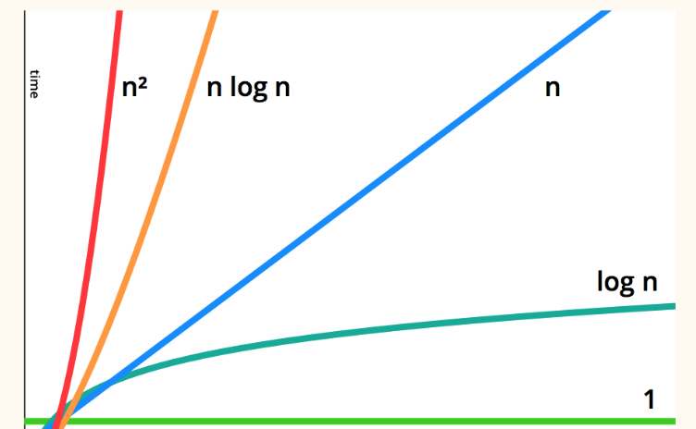
Big-O (Asymptotics)
Back to Topics List
Measures the efficiency of code, NOT runtime
Rate at which number of operations increases as input size grows
Big O of a program is the worst possible case (bounding curve)
Big-O (Best -> Worst)
O(1)
O(log n)
O(n)
O(n log n)
O(n^k)
O(k^n)
O(n!)

Slide 58
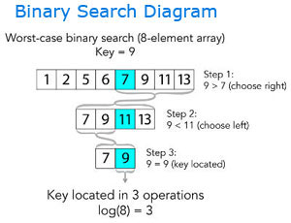
Searching
Back to Topics List
Linear Search O(n): iterate through the list and check every element
Binary Search O(log n): array must already be sorted
Check if middle element is the target
If middle is less than target, look at the right half of the array
If middle is greater than the target, look at the left half of the array
Rinse and repeat until element is found

Slide 59
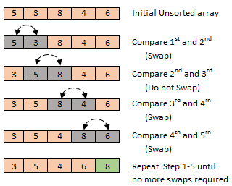
Sorting - Bubble Sort
Repeatedly swap adjacent, out-of-order elements through the array, moving (bubbling) the largest element to its proper location
Optimized to stop after a pass where no swaps are made
For an array of size n, bubble sort runs through the array swapping elements at most (n – 1) times and hence is O(n²)

Slide 60
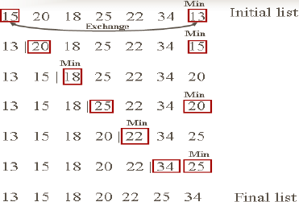
Sorting - Selection Sort
‘Select’ the smallest/largest to the right of the current position and swap that element with the current position
After k iterations, the first k elements are sorted and in their final positions
Selection sort is also O(n²)

Slide 61
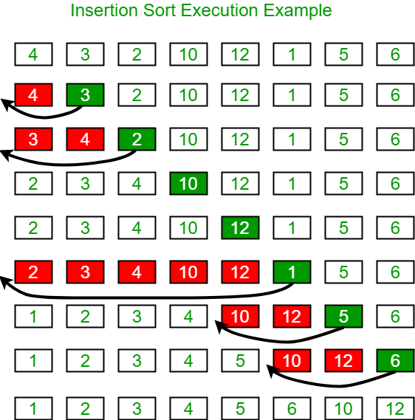
Sorting - Insertion Sort
Back to Topics List
Works by dividing the array into 2 subarrays, a sorted part and an unsorted part, and “inserting” the elements from the unsorted part one by one into their correct locations
After k iterations, the first (k + 1) elements are sorted but not necessarily in their final positions
Insertion sort is also O(n²)

Slide 62
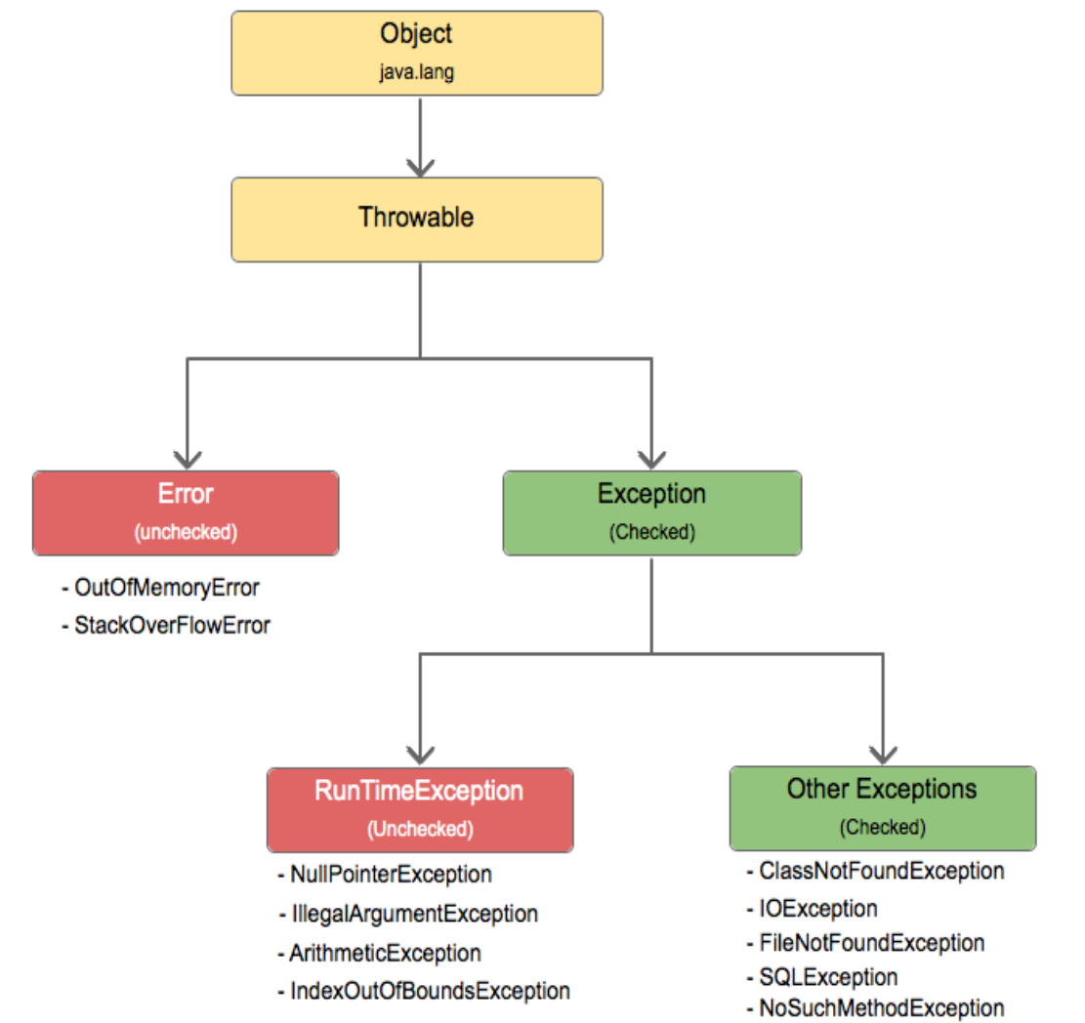
Exceptions
Objects that represent an issue or a condition that prevents execution from proceeding normally
Extend Throwable
Checked vs Unchecked
Checked Exceptions must be handled (caught by compiler)
Unchecked Exceptions can be handled
Extend RunTimeException

Slide 63
Handling Exceptions
Back to Topics List
Do nothing and let program crash (not allowed for Checked Exceptions)
Try-Catch block (handle it right away)
Try block holds problematic code
Catch block runs if specified Exception is caught
Finally block always runs
Throw to another method (propagation)
Use keyword throws in method header
throw new Exception(“This is an error message”);

Slide 64
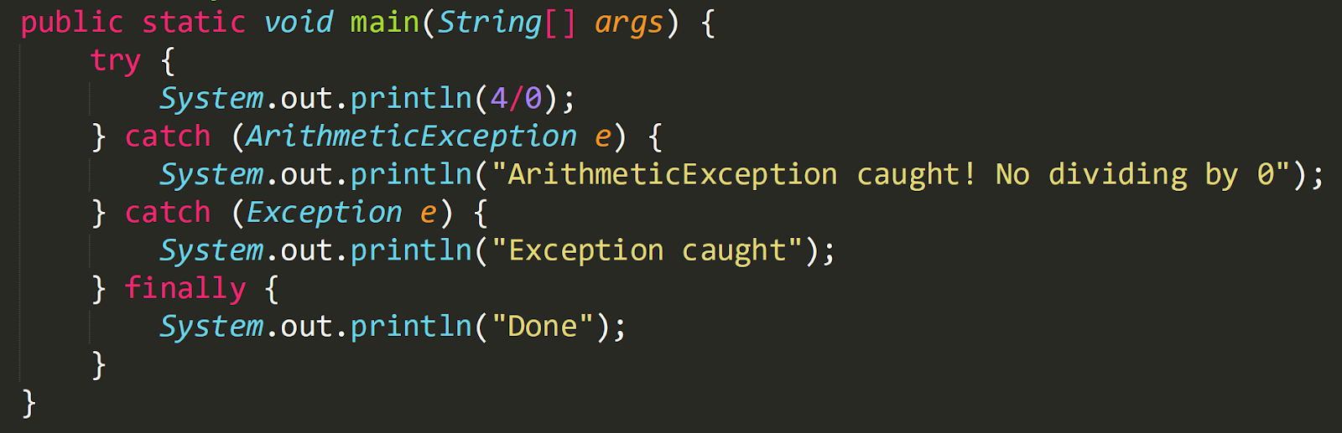

Handling Exceptions
Back to Topics List

Slide 65
File I/O
Allows us to manipulate text or binary files
File:
must import java.io.File;
Create a new File Object using File(“C:\\filepath.txt”)
Can use absolute path or relative path (relative to java file)
Reference the Java API for useful methods:
https://docs.oracle.com/en/java/javase/11/docs/api/java.base/java/io/File.html
Input:
Use Scanner or FileReader
Output:
Use PrintWriter
Must flush( ) and close() PrintWriter to correctly save changes to the file!!

Slide 66




File I/O (examples)
Back to Topics List

Slide 67

Recursion
Method that calls itself until some base case is reached
Recursive Call: Method calling itself
Method call gets placed on top of the stack
Base Case: Last form of the input
Ends recursive calls
Methods are executed on the stack
(last called -> first executed)
Approach the Base Case: changing our input with each call so we get closer to the base case
Similar to how we increment/decrement our counter in loops so that we hit the ending condition
Avoids infinite recursive calls

Slide 68

Recursion (example)
Back to Topics List
We can use Helper methods to make recursive calls easier
Note that with each recursive call, we decrement n to approach the base case n = 0
If n = 2, calls:
factorialHelper(2) –> returns 2 * factorialHelper(1)
factorialHelper(1) –> returns 1 * factorialHelper(0)
factorialHelper(0) –> returns 1

Slide 69

Java FX: Basics
Back to Topics List
JavaFX classes extend Application
Must override public void start (Stage primaryStage)
launch() method goes in main() to create GUI
Must make many imports from javafx
GUI Elements:
Stage: window which holds all other components you create
Scene: contains the objects for the GUI in a scene graph
Pane: area within the scene for putting GUI Objects
Node: individual GUI Objects

Slide 70
Java FX: Shapes, Colors, & Images
Back to Topics List
Shape – abstract base class for all Shapes
Ex. Shape rec = new Rectangle(400, 300, 20, 30);
rec.setFill(Color.GREEN);
Color – class to create Colors represented by a double value in the range of 0.0 - 1.0 or 0 – 255
Ex. Color b1 = new Color(0, 0, 1, 0);
Ex. Color b2 = Color.BLUE;
Image – class to represent an image from a file
To show an image you must create an ImageView object
Ex. Image img = new Image (“images/cs1331logo.png”);
ImageView imgView = new ImageView(img);

Slide 71

Java FX: Layout
Back to Topics List
Class | Description
Pane | Base class for layout panes. It contains the getChildren() method for returning a list of nodes in the pane
VBox | Places the nodes in a single column
HBox | Places the nodes in a single row
GridPane | Places the nodes in the cells in a two-dimensional grid
StackPane | Places the nodes on top of each other in the center of the Pane
FlowPane | Places the nodes row-by-row horizontally or column-by-column vertically
BorderPane | Places the nodes in the top, right, bottom, left, and center regions

Slide 72
Event-Driven Programming
Programming paradigm in which the flow of program is determined by events that are processed using handlers
Inner Classes – Declared inside another class
Have access to all attributes and methods of the enclosing class, including private ones
Can do everything a normal class can
Anonymous Inner Classes - Similar to an inner class, but without a class name
Declared and instantiated at the same time
Often used for one-time event handlers
Lambda Expressions - Syntactic sugar for an anonymous inner class
Can only be used to implement functional interfaces
3 parts: argument list, arrow token, & method body

Slide 73


Event-Driven Programming (examples)
Back to Topics List

Slide 74

Java FX: Events
Back to Topics List
Event object holds details of what happened and is outputted from a source Object (i.e. Buttons)
Many different classes extend Event including ActionEvent, KeyEvent, MouseEvent, etc.
EventHandler listens for a specific Event and processes it
Must be an instance of EventHandler<T extends Event> interface
Must be registered with an event source object using source.setOnAction(EventHandler<T extends Event>)

Slide 75
ADTs
Back to Topics List
ADT - Abstract Data Type → a data type whose creation and modification are constrained to a contract
This contract defines the behavior of data structures, and in Java, these are typically interfaces
Concrete Data Structures implement an ADT
ADT | Description
Set | For storing unordered and unique elements
List | For storing elements in an ordered fashion so they can be indexed
Stack | For storing elements in a Last-in First-out (LIFO) fashion
Queue | For storing elements in a First-In First-Out(FIFO) fashion

Slide 76

LinkedList
Back to Topics List
Implements the List<T> interface
Made up of Node Objects each containing:
data - generic data type (all nodes hold the same data type)
next - reference to the next Node in the List
prev – optional reference to the previous Node to make the list doubly linked
Without this reference, the List is singly linked
head - field in the LinkedList class that points to the first node
tail - optional field in the LinkedList class that points to the last node

Slide 77
Collections
Framework designed to provide an architecture to store and manipulate a group of objects
Useful methods that every collection will implement:
boolean add(E e)
boolean addAll(Collection<? extends E> c)
void clear()
boolean contains(Object o)
boolean isEmpty()
boolean remove(Object o)
int size()
Object[] toArray()
Set<E>, List<E>, Queue<E>,& Stack<E> all extend Collection<E>

Slide 78

Iterator / Iterable
Back to Topics List
Iterator<E> - Defines the methods that allow for a collection to be iterated through
boolean hasNext()
E next()
Iterable<E> - A collection which can be iterated through
Iterator<E> iterator()
Collections implements Iterable

